Slide 1

Nanthitha R
232DA021 ELECTRICITY THEFT DETECTION IN SMART GRIDS BASED ON DEEP NEURAL NETWORK
E-mail: 232DA021@drngpasc.ac.in
Under the Guidance: Mrs.S.Govardhini (Assistant Professor) MCA, M. Phil., TN – SET, UGC-NET, B.Ed.

Slide 2

TITLE
ELECTRICITY THEFT DETECTION IN SMART GRIDS BASED ON DEEP NEURAL NETWORK
NANTHITHA R
Dr.NGPASC
Coimbatore,Tamil Nadu, India

Slide 3
OBJECTIVES
Develop a deep neural network-based model to detect electricity theft in smart grids with high accuracy.
Improve data quality by addressing missing values and class imbalance using interpolation and synthetic data generation.
Identify and validate the most relevant features using PCA and minimum redundancy maximum relevance (mRMR) to enhance detection performance.
Dr.NGPASC
Coimbatore,Tamil Nadu, India

Slide 4
EXISTING SYSTEM
The data related to electricity consumption, power flow, and other relevant parameters is collected in the current system. Mention the sources of data, such as smart meters, sensors, and monitoring devices.
The collected data is processed in the current system. This may involve data aggregation, filtering, and analysis to identify patterns and anomalies.
For variables used in the current system for detecting electricity theft. This could include parameters like energy consumption patterns, voltage levels, and current flows.
Summarizing the performance of the current system in terms of its accuracy, reliability, and efficiency in detecting electricity theft.
Dr.NGPASC
Coimbatore,Tamil Nadu, India

Slide 5
PROPOSED SYSYTEM
As one of the major factors of the nontechnical losses in distribution networks, the electricity theft causes significant harm to power grids, which influences power supply quality and reduces operating profits.
In order to help utility companies solve the problems of inefficient electricity inspection and irregular power consumption, a novel hybrid convolutional neural network-random forest (CNN-RF) model for automatic electricity theft detection is presented in this project.
In this model, a convolutional neural network (CNN) firstly is designed to learn the features between different hours of the day and different days from massive and varying smart meter data by the operations of convolution and down sampling.
In addition, a dropout layer is added to retard the risk of overfitting, and the backpropagation algorithm is applied to update network parameters in the training phase. And then, the random forest (RF) is trained based on the obtained features to detect whether the consumer steals electricity. To build the RF in the hybrid model, the grid search algorithm is adopted to determine optimal parameters.
Finally, experiments are conducted based on real energy consumption data, and the results show that the proposed detection model outperforms other methods in terms of accuracy and efficiency.
Dr.NGPASC
Coimbatore,Tamil Nadu, India

Slide 6
ADVANTAGES OF PROPOSED SYSTEM
High Accuracy
High Efficiency
Less Time consumption
Dr.NGPASC
Coimbatore,Tamil Nadu, India

Slide 7
TOOLS AND TECHNOLOGY
Operating system : Windows 7 Ultimate
Coding Language : Python
Front-End : HTML
Back-End : Django-ORM
Designing : Html, css, javascript
Data Base : MySQL (WAMP Server)
Dr.NGPASC
Coimbatore,Tamil Nadu, India

Slide 8
NOVELTY
The novelty of your project lies in the application of deep neural networks (DNNs) for electricity theft detection in a smart grid. This approach offers several unique advantages over traditional methods:
Advanced Pattern Recognition: DNNs can effectively learn complex patterns and relationships from large-scale data, enabling them to detect subtle anomalies indicative of electricity theft. This ability surpasses the capabilities of traditional statistical or rule-based methods.
Efficiency: Once trained, DNN models can process data rapidly, allowing for real-time or near-real-time detection of theft incidents. This can lead to quicker response times and reduced losses for utility companies.
Improved Accuracy: The inherent learning capabilities of DNNs can lead to more accurate detection of theft incidents while minimizing false alarms, improving the overall efficiency of theft detection systems.
Dr.NGPASC
Coimbatore,Tamil Nadu, India

Slide 9
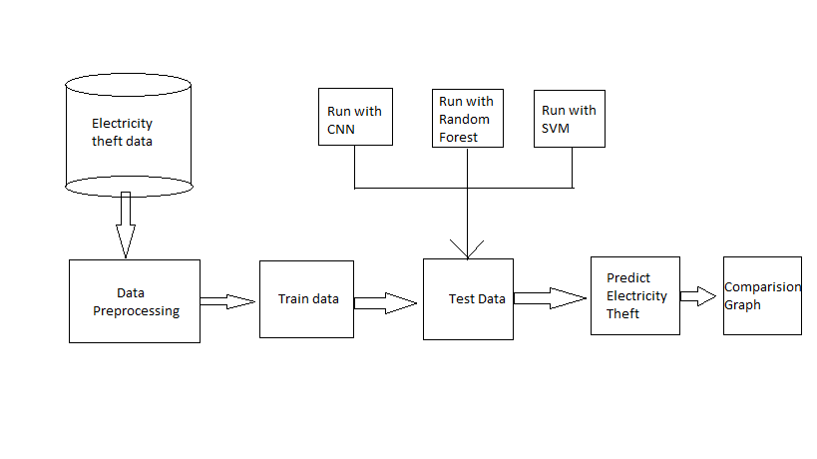
ARCHITECTURE
Dr.NGPASC
Coimbatore,Tamil Nadu, India

Slide 10
FUTURE SCOPE
In the future, a project on detecting electricity theft in smart grids using deep neural networks could grow in several ways. Firstly, the accuracy of the detection system could be improved by using more advanced algorithms and tweaking the settings to make it more precise. Secondly, the system could be made faster to detect theft as it happens, by optimizing how it processes data from smart meters and other sensors. Thirdly, it could be expanded to look for unusual patterns in electricity use that might suggest theft, even in cases where traditional methods might not spot it. Fourthly, the system could be made to work efficiently in very large smart grid networks with millions of users.
Additionally, it could be integrated more closely with other parts of the smart grid, like smart meters and control systems, to make monitoring and control easier. Data privacy and security would also be a big focus, making sure that sensitive information is kept safe. Finally, the system would need to follow all the rules and standards for detecting electricity theft and protecting data, which can vary depending on where it's being used.
Dr.NGPASC
Coimbatore,Tamil Nadu, India

Slide 11
CONCLUSION
Improved Accuracy: The deep neural network will effectively detect electricity theft with high precision by learning abnormal consumption patterns.
Improved Accuracy: The deep neural network will effectively detect electricity theft with high precision by learning abnormal consumption patterns.
Enhanced Data Quality: Preprocessing techniques, including interpolation and synthetic data generation, will address missing values and class imbalance.
Feature Optimization: Principal Component Analysis (PCA) and Minimum Redundancy Maximum Relevance (mRMR) will help identify the most influential features for theft detection.
Superior Performance: The proposed method will outperform existing techniques when evaluated on the same dataset, demonstrating its effectiveness in smart grid security.
Dr.NGPASC
Coimbatore,Tamil Nadu, India

Slide 12



